Slide 1
Credit Card Fraud Detection using Machine Learning
Presented by
Joykishan Sharma(46)
Arindam Saha(60)
Imteaz Alam(48)
Sankhadip Das(20)
Somnath Paul(15)
BCA department of NSEC

Slide 2
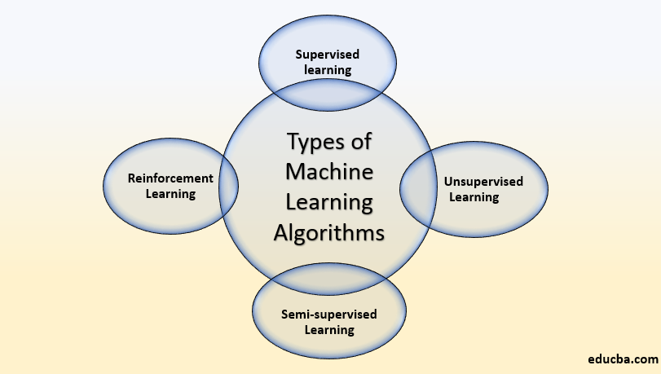
Introduction
Artificial intelligence (AI) is an area of computer science that emphasizes the creation of intelligent machines that work and react like humans.
Machine learning is an application of artificial intelligence (AI) that provides systems the ability to automatically learn and improve from experience without being explicitly programmed.

Slide 3
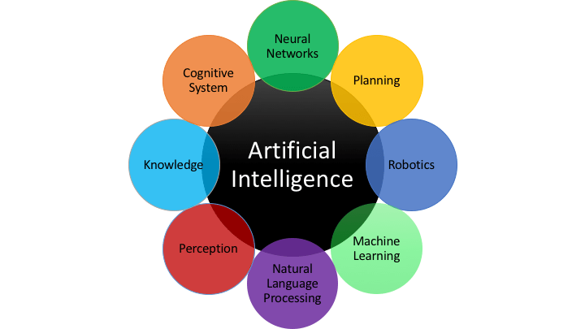
Application of AI

Slide 4
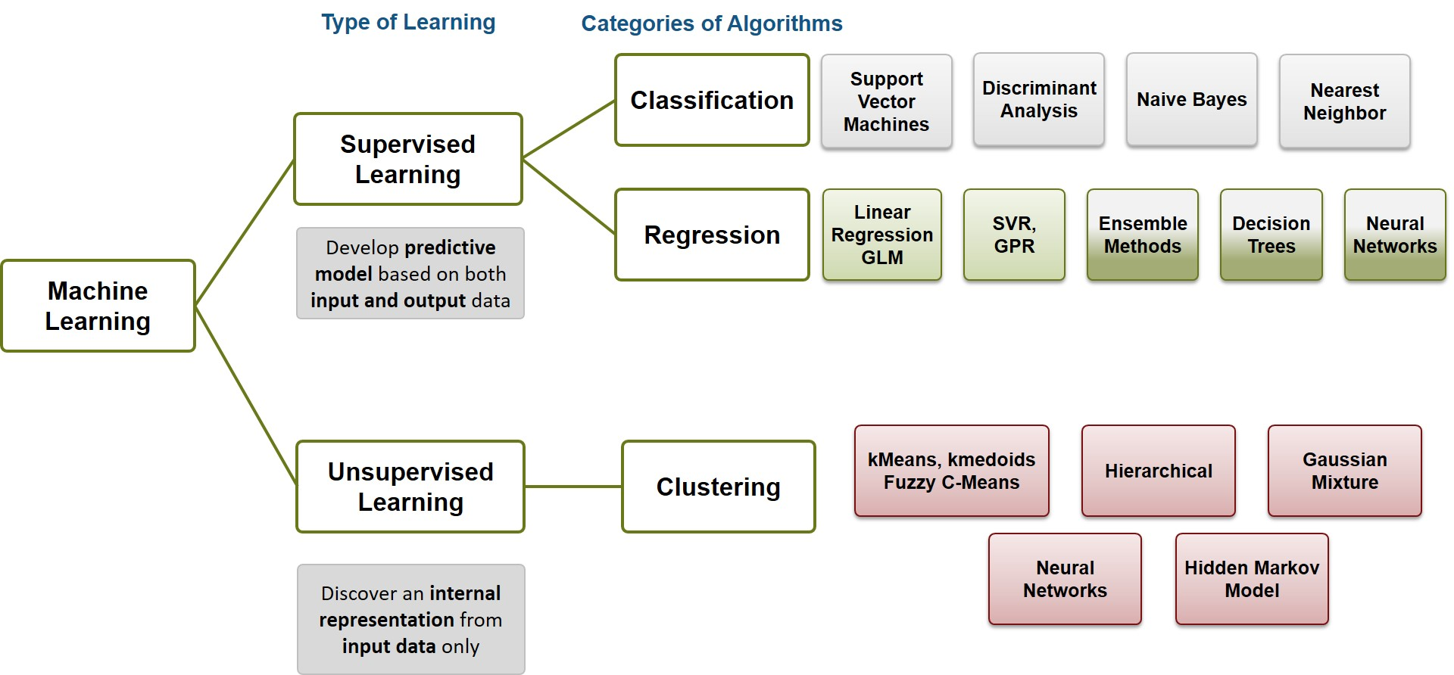
ML classification

Slide 5
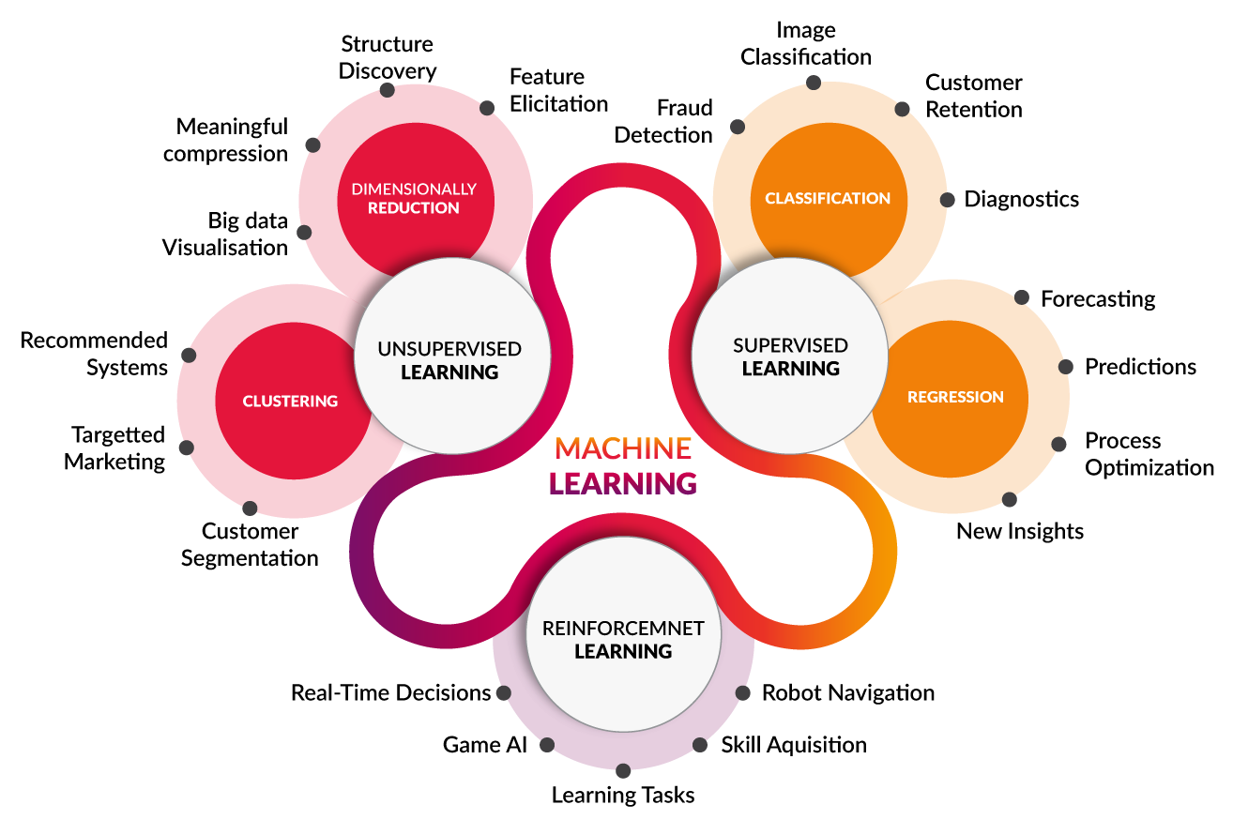
Applications of ML

Slide 6
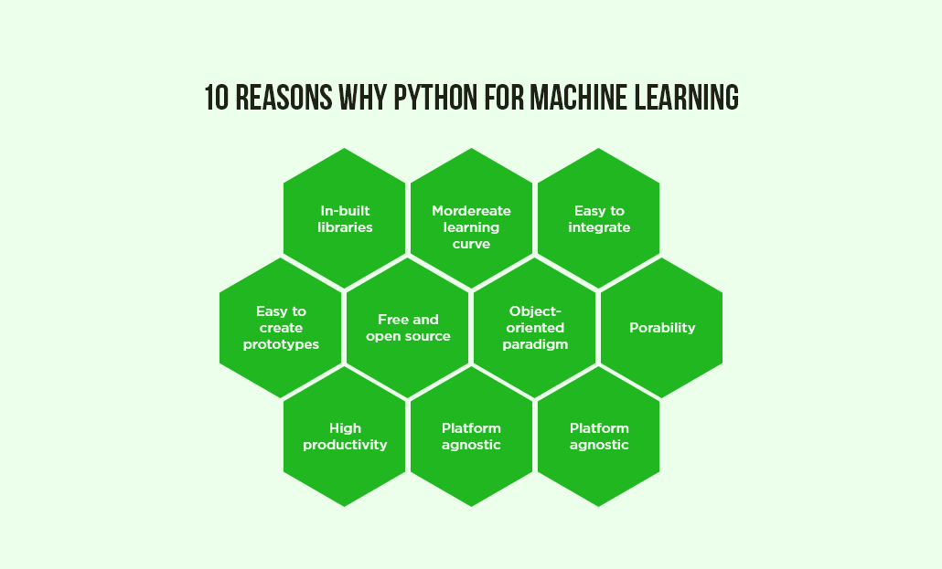
Why python?

Slide 7

Packages in Python for ML

Slide 8
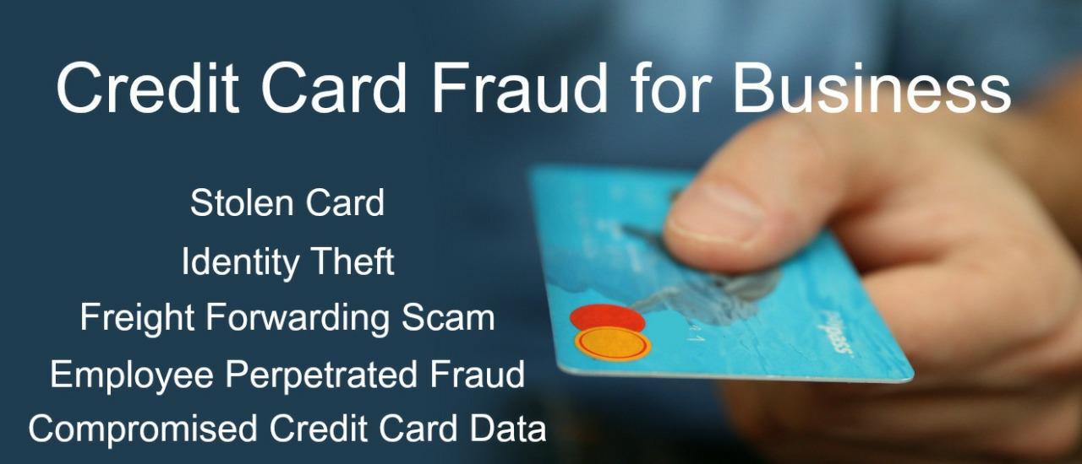
About Project
Problems -
Solutions- Machine Learning helps a lot when it comes to fraud detection. It tries to identify hidden patterns that help in detecting a fraud which is not been previously recognized.

Slide 9
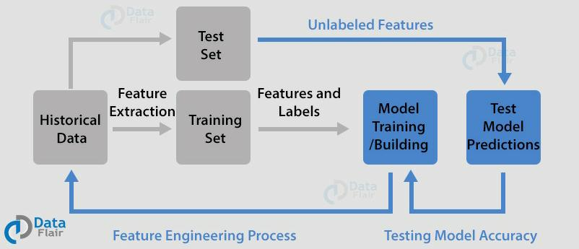
Flow Chart of our Project

Slide 10
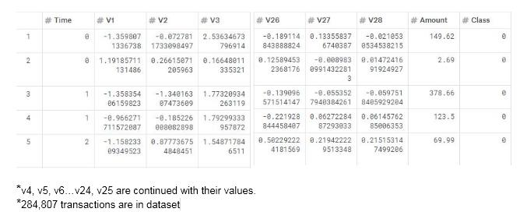
Dataset of our project

Slide 11
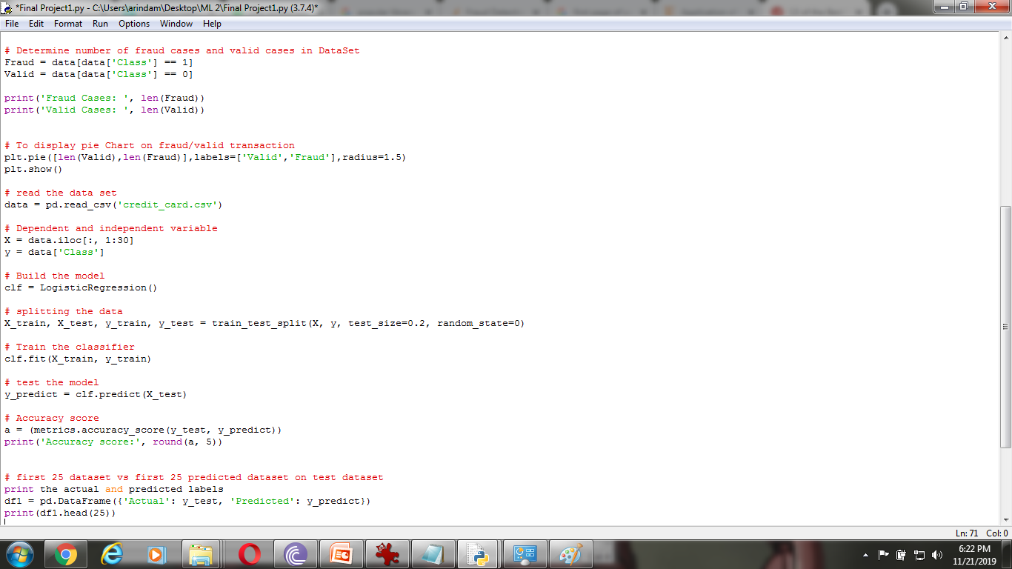
Deep Dive into Main Code

Slide 12
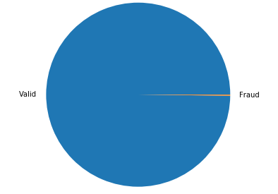

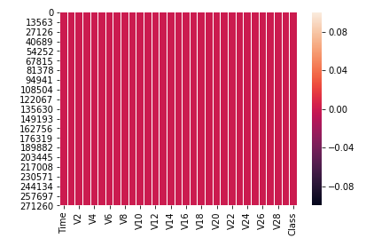
Visual representation of data

Slide 13
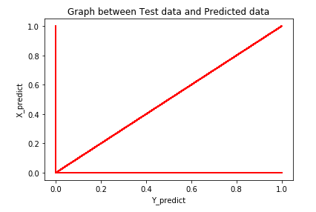

Final Accuracy Score

Slide 14
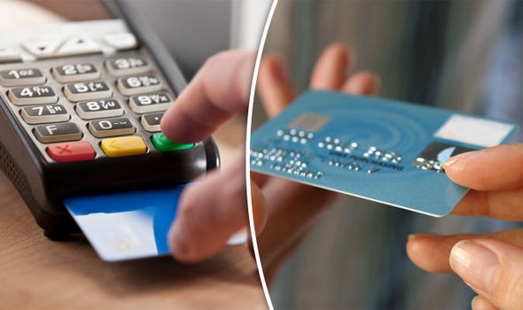
Conclusion
Fraud detection is a complex issue that requires a substantial amount of planning before throwing machine learning algorithms at it. Nonetheless, it is also an application of data science and machine learning for the good, which makes sure that the customer’s money is safe and not easily tampered with.
Future work will include a comprehensive tuning of the Logistic Regression algorithm I talked about earlier. Having a data set with non-anonymized features would make this particularly interesting as outputting the feature importance would enable one to see what specific factors are most important for detecting fraudulent transactions.

Slide 15

Acknowledgement
We are very thankful to our college Netaji Subhash Engineering college and we are also thankful to our project guide Piyali Mukherjee of our college Netaji Subhash Engineering college. we are thankful to our training guide Sofikul Mullick of ENGINEERS STUDY CENTRE for giving us opportunity to do this awesome project Credit Card Fraud detection using machine learning.
We are also thankful to www.kaggle.com/ for providing us with the Dataset to do this project.

